Slide 1
Java 4 WEB
Lesson 3 – Home tasks overview

Slide 2
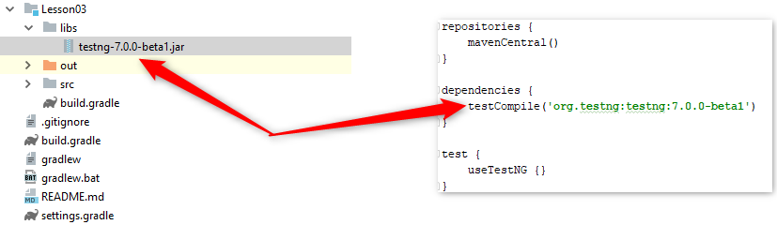
1. Duplicated declaration of libs
Notes:
Very well that now all students committed lib for testing

Slide 3

2. Always use this. Or super. prefix

Slide 4

2. Always use this. Or super. prefix

Slide 5
3. Do not user inner ternary operator
Notes:
Very hard to read and change. Can you find a mistake?

Slide 6
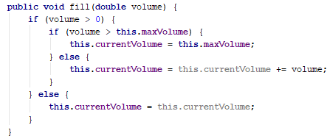
3. Do not user inner ternary operator
Notes:
Simple to read and change. Extra reassignments to itself can be removed

Slide 7
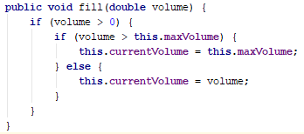
3. Do not user inner ternary operator
Notes:
Extra reassignments to itself removed
Can you find another one mistake?

Slide 8
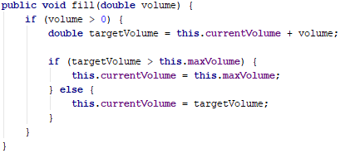
3. Do not user inner ternary operator
Notes:
The gas bank was filled over itself max value

Slide 9
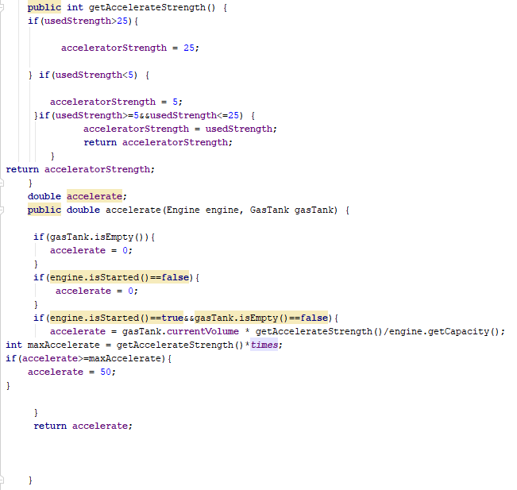
4. Format code
Notes:
Who can guess where is the methods begin/end?

Slide 10
5. Bad commit messages
L03-T1 implemented interface Drivable, StatusAware, ControlPanel; classes ControlPanelImpl, Vehicle and his inheritors, Accelerator, BrakePedal, Engine, GasTank, SteeringWheel.
L03-T1 Part of vehicle
L03-T1 { Task 1 }
L03-T1 Implements test cases ControlPanelImplTest.class
Notes:
Good commit message is 5-10 words (no exclusions)
Try to not repeat commit messages

